Slide 1

honf dențiai

Slide 2

Executive Summary: Building a Living Intelligence System
The Objective
I
The Method
The Pilot
I
The Outcome
Secure Maritide s dominance
in the $1T obesity
market by identifying True Early Adopters 90 days post-launch.
Learning from Analogues
A 3-Model AI Framework simulating history (Wegovy, Zepbound, Oral
The Liphtfiouse Strategy
Utilization of the 2026 Orforglipron launch as a live simulation to validate
A ranked, defensible target list with 'Why Now' rationale for proactive field deployment, enabling enabling surgical
I
I
IaunchesJ to triangulate future behavior and decode adoption DNA.
accuracy (Target: 60% rising to 80%) before Maritide market entry.
Shift from Business Intelligence (What happened?) tO Predictive Intelligence (Who will prescribe*).

Slide 3

The 2026 landscape demands more than volume-based targeting.
Transition Year: Oral + Injectable Mix
Maritide Launch: Maintenance DOminance
2024
2025
2026
2027
We cannot simply target high-volume writers; we must identify physicians with the ’Behavioral DNA’ for innovation.

Slide 4
Descriptive (TraditionaI) Model
s a e9› v i e sh n Predictive (Project Beacon) Model
I
Data Scope: Static pharmacy fill data
Data ScOpe: Triangulated claims, EHR, and behavioral logs
Market Context: Incorporates shortages, Medicare Part D, and DTC shifts
Market Context: Assumes stable conditions
HCP Insight: What the doctor did
HCP Insight: Why the doctor will act
oãCtive,prescriptifvieeld
ntã:e::::t” I
Actionability: Reactive resource allocation

Slide 5

Solution Architecture: A Three-Phase ML Approach
Phase1: Patient | “ | Phase 2: HCP Behavioral | “ | Phase 3: Opportunity
Discovery |  | Segmentation |  | Prediction
Quantify addressable universe.
Build cOmmerci view of
Connect demand to supply.
Ident fy high-conversion
400,000 prescribers.
Produce ranked target list
moments (BMI › 30,
Distinguish early adOpters
with Why Now rationale.
metabolic deterioration).
from laggards.
Increasing Revenue Acceleration

Slide 6
Simulating history to predict the future.
Model 1:
Model 2:
Model S:
Category Creation
Switching Dynamics
Disruption
Analog: Zepbound
Analog: Orforglipron
Analog: Wegovy
(2026)
innOvation-IO ŁWôFd
HCPs migrating
Insight: Identifies
HCPs.
patients for better
HCPs sensitive to
outcomes.
injection fatigue.

Slide 7


Why one data source isn t enOugh.
IQVIA LAAD
(1 hu \cccss Layer)
Mapping paket fric tion and abandonmen I tates 40% I ejection). Identifies valid palienI volume
IQVIA Xponent
DCIe rent iate ¢ Early Ca ta1ys Is
from High -Volume Laggards.
Opium EHR
Identifying clinical readiness.
BMI, Labs, NLP lor 'Injection Fatigue’
!Jses P odabllistic Inference lor missing codes

Slide 8
Innovation-Forward.
Efficacy—Driven. Moses
Lifestyle-Focused.
Rapidly adopts new tech.
patients for better outcomes.
Prioritizes ease of use.
First 90-day writer for
High patient turnover between
High Ol me of Oral scripts;
Wegovy & Zepbound.
GLP-1 brands.
needle aversion in panel.
Target with early trial da ta | ’ Convenience + Efficacy" | Education on Maritide dosing
& speaker programs. | messaging. | frequency.

Slide 9
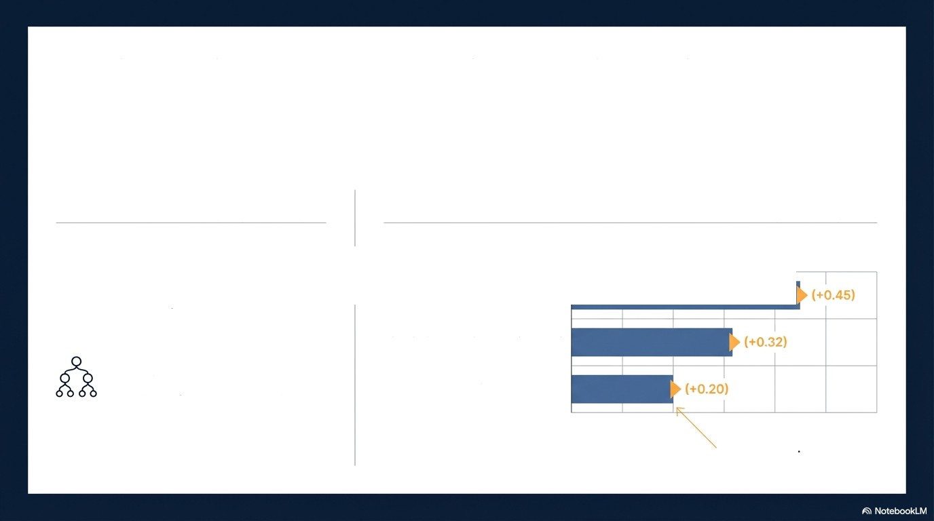



Technical Deep Dive: Advanced Analytics with Explainability
The Engine The "Glass Box” Explainability
Unsupervised Clustering: Grouping 400k physicians by adoption behavior, not geography.
Example SHAP Contribution Analysis
High Zepbound Switching
Metabolic Deterioration in Panel
XGBoost (Gradient-Boosted Trees): High-accuracy scoring of adoption likelihood.
History of Oral Adoption
We don't just give a
score; we give a reason.

Slide 10
Proving the model by simulating the 2026 competitor launch.
Jan 2026
April 10, 2026
June 2026
Aug 2026
Sept 2026
MOdeI Finalized
FDA Target Action
Initial Market Read
Maritide Model
(Ba seline Predictions)
Date {Launch)
(First 90—day Data)
Validation Report
RecalibŁätiOn
Target Accuracy: 60% Initial -+ 80% Post-Calibration
Model performance improvement following initial real-world data ingestion
and recalibration against OrfOrgl pron launch data.

Slide 11
The model adapts to pricing shocks and Medicare expansion.
Channel
EGt. Monthly Cost
Model Impact
Medicare Part D (Pilot st‘’‘s
April 1, 2026)
$245 (Capped)
Identify HCPs with high Medicare-eligible
patient skew.
Track non-traditional adoption signals outside PBMs.
TrumpRx.gov (Cash Pay)
' $350
Li yDirect (DTC Oral)
$149 (Start DOse)
Monitor telehealth-friendly physicians.

Slide 12
Model
Data &
Maritide
Mapping

Slide 13
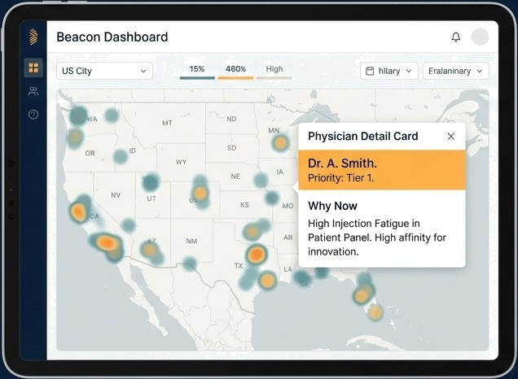
DeliVering actionable intelrgence to the field.
Use Cases:
- Field Force: Prioritized routing based on 'Why Now' ratiOnale.
Marketing Segment-specific
messaging (Convenience vs. Efficacy).
Strategy Identification of new KOLs leading the oral wave.

Slide 14
1. Immediate Actions
Secure TPA Access: Optum, IQVIA LAAD, Xponent.
Align Protocol: C4 Center for Research data sharing.
Schedule Market Definition Workshop.
Key Workshop Decision
  Adoption Window: 90-day (Innovator) vs. 180-day?
  Hypothesis: Defining Action Moments' in patient journey.
Governance
  Bi-weekly progress reviews with Steering Committee.

Slide 15

Future Growth
Project Beacon transitions Amgen from reacting to
market shifts to anticipating them.
By learning from the Orforglipron launch in 2026, we ensure Maritide captures the Maintenance market from Day 1.
Ready fÒr Mobilization.

